Slide 1
Capstone Project -3
Appliance Energy Prediction By:- Rohit Kumar Sharma

Slide 2

Let’s Catch The Defaulters
Defining problem statement
EDA and feature engineering
Feature Selection
Preparing dataset for modelling
Applying Model
Model Validation and Selection

Slide 3

Defining Problem Statement
In this time of global uncertainty world needs energy to support economic and social progress and build a better quality of life, in particular in developing countries. But even in today’s time there are many places especially in developing world where there are outages.
These outages are primary because of excess load consumed by appliances at home. Heating and cooling appliances takes most power in house. In this project we will be analyzing the appliance usage in the house gathered via home sensors. All readings are taken at 10 mins intervals for 4.5 months . The goal is to predict energy consumption by appliances .
In the age of smart homes, ability to predict energy consumption can not only save money for end user but can also help in generating money for user by giving excess energy back to Grid (in case of solar panels usage). In this case regression analysis will be used to predict Appliance energy usage based on data collected from various sensors.

Slide 4
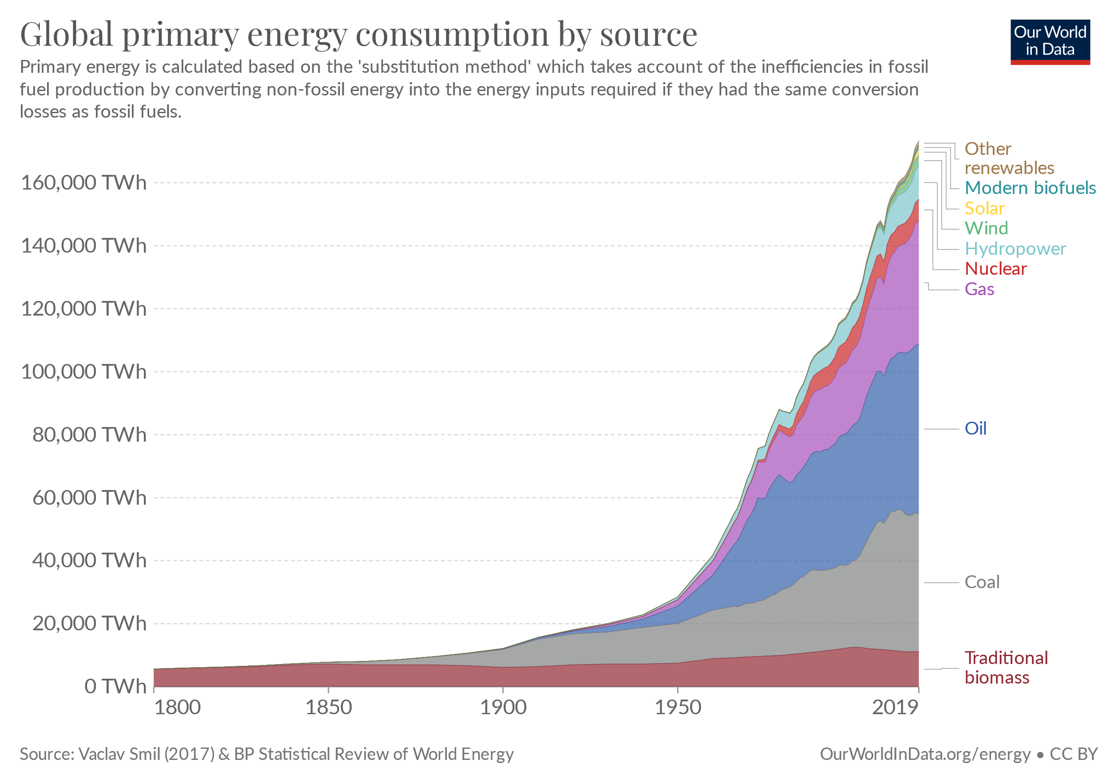

Slide 5
Introduction
We should predict Appliance energy consumption for a house based on factors like temperature, humidity & pressure . In order to achieve this, we need to develop a supervised learning model using regression algorithms. Regression algorithms are used as data consist of continuous features and there are no identification of appliances in dataset

Slide 6
Data Pipeline
Data processing- 1 : In this first part we’ve removed unnecessary features, renaming columns. Since there were no columns with null values.
EDA : In this part, we will handle missing values and see the distribution of data. We also compare independent variable.
Feature Selection: In this part we will try to capture all the important, interesting features in a data set with respect to an outcome variable.
Data Pre-processing: In this part we will standardized and normalized our data in order to reduce the computation time.
Models and Prediction: In this part we will split our data and do some feature scaling, after that we will train our model. At last we will compare our model to get an outstanding model.

Slide 7
Data summary
Collections of temperature and humidity in kitchen, living room, laundry room, office room, bathroom, ironing room, outside house.
Wind speed
Visibility
Tdewpoint: It tells dew point temperature
Appliances : It tells how much energy is used(measure in W-h)

Slide 8
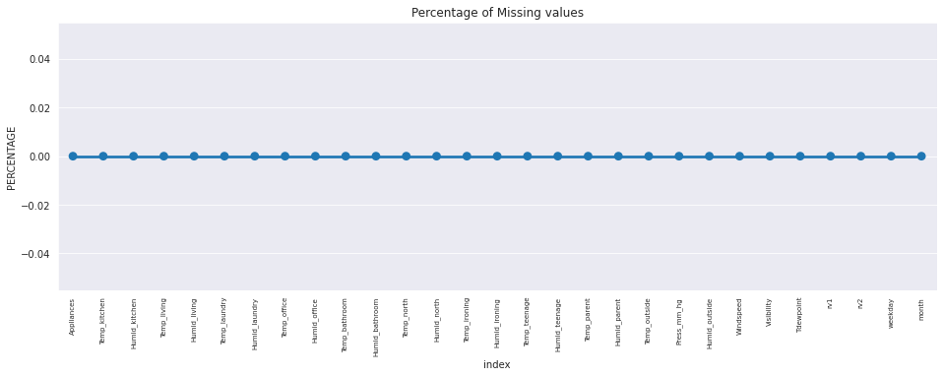
EDA

Slide 9
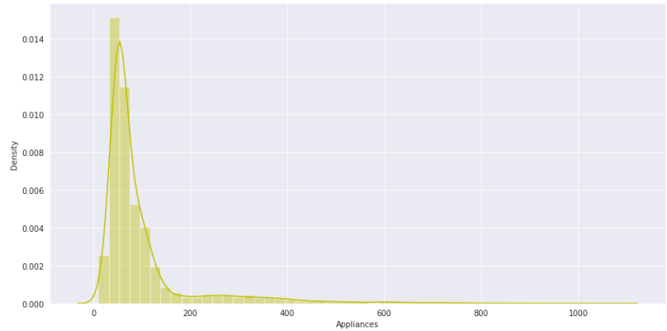
EDA – Dependent Variable

Slide 10
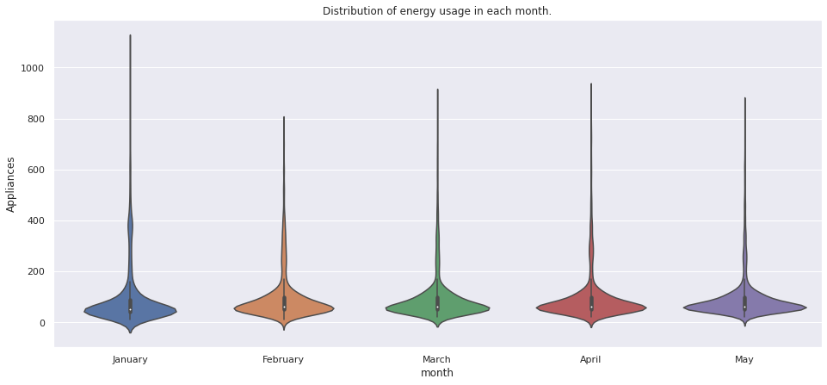
EDA
This graph shows Distribution of energy in each month:
Violin plot shows probability of usage.

Slide 11
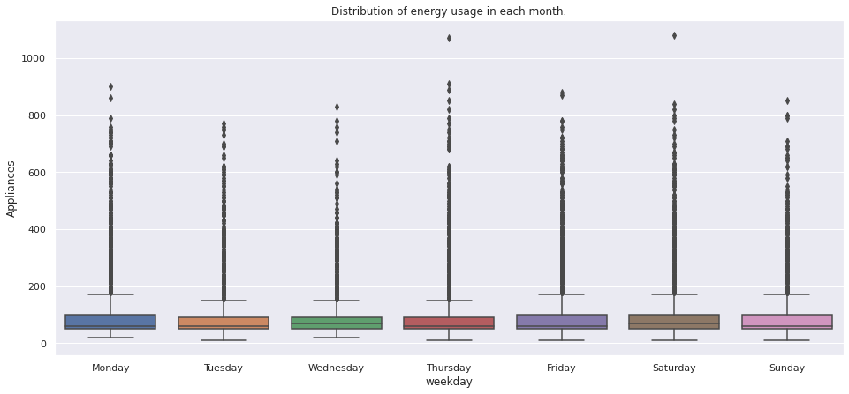
EDA
Distribution of energy usage in week days.

Slide 12
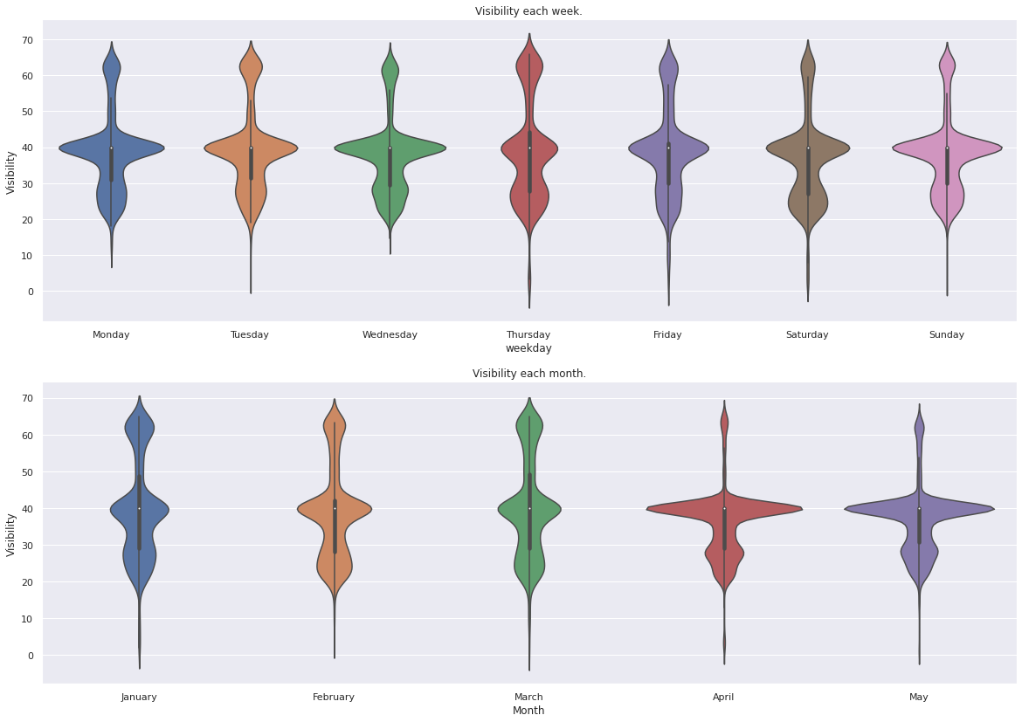
EDA
Distribution of visibility each week and month

Slide 13
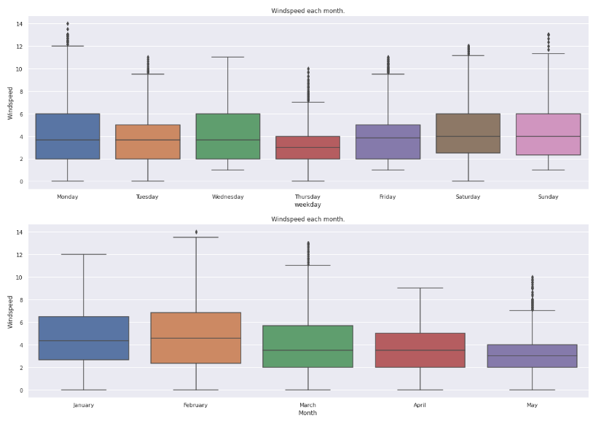
EDA
Graph shows windspeed monthly and weekly wise.
Windspeed in April and may are lower than other month.

Slide 14
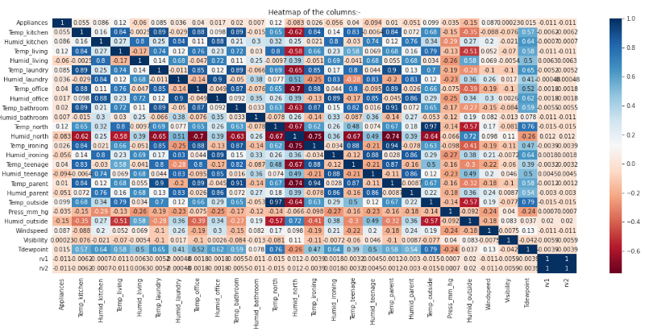
Feature Selection
Top features are selected on the basis of collinearity. All those features which were increasing multicollinearity.

Slide 15
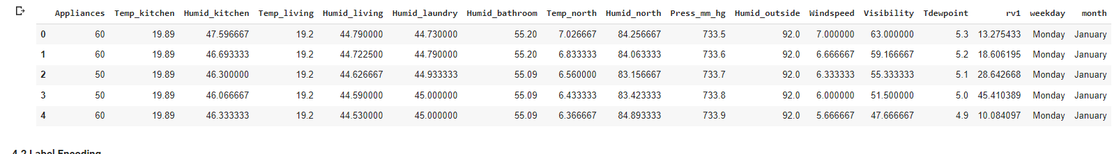
Preparing Dataset for modelling
Task :- Regression analysis
Train set:- (13814,33)
Test set :- (5921,33)
Response:- Energy used

Slide 16
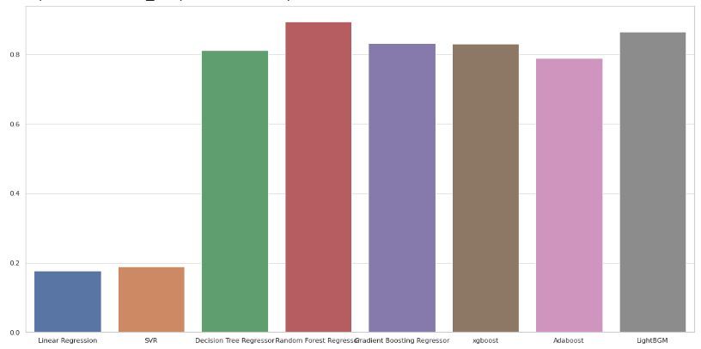
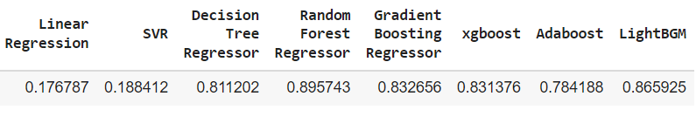
Modelling and Selection

Slide 17

Model Validation & Selection
Observation 1: As seen in the above graph, Linear Regression is not giving great results, Gradient Boosting and LGBM are better than Linear Regression.
Observation 2: Gradient Boosting, Xgboost, Adaboost, are giving better results but Random forest regressor is giving best score among them.

Slide 18

Model Validation & Selection(continued)
Observation 3: From the above observation we have come to the conclusion that we would choose Random forest regressor model.
Its score is 0.89

Slide 19
Applying Models – Hyperparameter Tuning
Random Forest Regressor - Parameters
Bootstrap: false, max_depth: None, max_features:12, min_samples_split: 7, n_estimators: 485
Gradient Boosting Regressor - Parameters
n_estimators: 50, max_depth: 9, learning_rate: 0.1

Slide 20
After Hyperparameter Tuning
Random forest Regressor score is :- 0.9
Random Forest Regressor is giving Good score even after tuning so we will use it
Gradient Boosting Regressor score is :- 0.87

Slide 21
Conclusion
Linear Regression has the least Adj R2 score, hence it is underfitting.
Random Forest Regressor is the best model which gives score of 0.89 before tuning and after hyperparameter tuning 0.9
Gradient Boosting Regressor after Hyperparameter Tuning is also giving good score approximately .87
Windspeed is little bit effecting appliances usage

Slide 22
Challenges
Huge chunk of data was to be handled keeping in mind to miss anything which is even of little relevance.
Feature selection was quite a challenge as our dataset had many features that were independent of each other.
Computation time (especially during Hyperparameter Tuning)
Quite large Dataset.

Slide 23
Thank You

